Slide 1
COVID-19 EFFECTS ON UNIVERSITY ATTENDANCE
Suveenawan Suttinual (Beam)
Tanya Danish

Slide 2
Education and Covid-19
A new approach; remote working and hybrid learning
University holing ‘pop up’ clinics for the vaccine
International students being pushed to register with their local GP
Travel requirements for international students made more difficult.
Red List countries
Quarantine

Slide 3
Attendance data before covid 19
Attendance for the 2018/2019 academic year in educational settings before the pandemic.
The data used by schools to record pupil attendance.
On average, the attendance before the pandemic would typically have been around 94% (Rowlands, 2022).
Rowlands, M. (2022). Attendance review -implications of the COVID-19 pandemic for school attendance. [online] Available at: https://www.gov.wales/sites/default/files/publications/2023-12/attendance-review-implications-of-the-covid-19-pandemic-for-school-attendance.pdf.

Slide 4
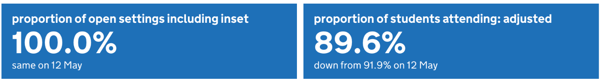
Attendance data during covid 19
Attendance for the 2021/22 academic year in educational settings.
The data from 21 April 2022 to 26 May 2022.
The on-site attendance percentage was 89.6% on May 26th, which is down from 91.9% on May 12th (Sasso, 2022).
The data used by satisfaction survey.
Sasso, R. (2022). Attendance in education and early years settings during the coronavirus (COVID-19) pandemic, Week 22 2022. [online] explore-education-statistics.service.gov.uk. Available at: https://explore-education-statistics.service.gov.uk/find-statistics/attendance-in-education-and-early-years-settings-during-the-coronavirus-covid-19-outbreak/2022-week-22 [Accessed 11 Mar. 2024].

Slide 5
Attendance data after covid 19
Attendance for the 2022/23 academic year in educational settings.
Gradual return to in-person teaching while maintaining elements of online learning.
Schools introduced hybrid learning models to accommodate different learning preferences.
University management continued emphasis on health and safety measures on campus.
Enhanced digital infrastructure and support for the remote learning technologies.

Slide 6
How Covid Affected Education in Third World Countries
PAKISTAN

Slide 7
UNIVERSITY ATTENDANCE IN PAKISTAN
BEFORE
DURING
AFTER
traditional semester system
- In-person lectures, labs, and exams conducted on campus.
- The admission process involves the submission of physical documents and in-person interviews.
- Limited availability of online learning resources and digital infrastructure.
- Universities transitioned to online learning.
- Challenges with internet and access to technology
- Delayed academic calendars and postponed examinations due to lockdowns.
- Schools adopted remote teaching methods, including video lectures and virtual labs.
- Integration of hybrid learning models.
- Improved digital infrastructure.
- Streamlined admission processes with increased use of online platforms.

Slide 8
MAPS
UK
Pakistan

Slide 9
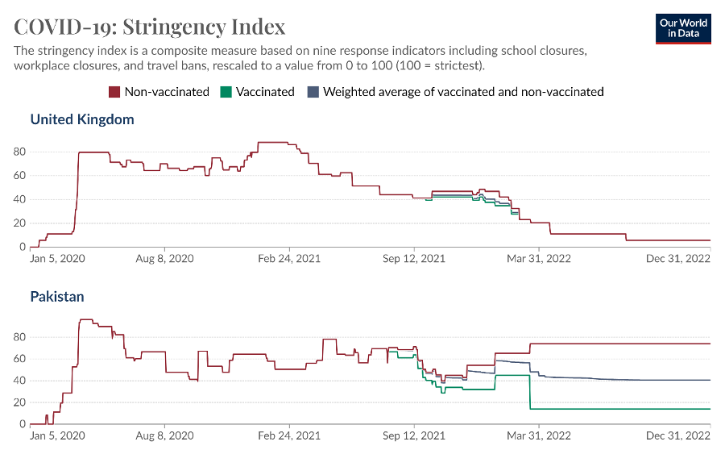
Data source: Our World in Data (2024)

Slide 10
Reference List
Coughlan, S. (2021a). Universities keeping lectures online into autumn term. BBC News. [online] 18 May. Available at: https://www.bbc.co.uk/news/education-57150071.
GOV.UK (2022a). Coronavirus (COVID-19) in the UK. [online] coronavirus.data.gov.uk. Available at: https://coronavirus.data.gov.uk/details/cases.
GOV.UK. (n.d.). Higher education providers: coronavirus (COVID-19). [online] Available at: https://www.gov.uk/government/publications/higher-education-reopening-buildings-and-campuses.
Institute for Government Analysis (2021a). Timeline of UK Coronavirus lockdowns, March 2020 to March 2021. [online] www.instituteforgovernment.org.uk. Available at: https://www.instituteforgovernment.org.uk/sites/default/files/timeline-lockdown-web.pdf.
learningportal.iiep.unesco.org. (n.d.). Measuring the impact of COVID-19 on education in Pakistan | Unesco IIEP Learning Portal. [online] Available at: https://learningportal.iiep.unesco.org/en/library/measuring-the-impact-of-covid-19-on-education-in-pakistan.
Wonkhe. (n.d.). What should universities do to prepare for COVID-19 coronavirus? [online] Available at: https://wonkhe.com/blogs/what-should-universities-do-to-prepare-for-covid-19-coronavirus/ [Accessed 9 Mar. 2024].
www.hesa.ac.uk. (n.d.). The impact of the COVID-19 pandemic on 2021/22 Student data | HESA. [online] Available at: https://www.hesa.ac.uk/insight/19-01-2023/impact-covid-19-2022-student-data.

Slide 11
Haugom, E., 2022. The effect of changing from campus-based to digital teaching on student attendance: A case study of Norwegian business students. Heliyon, 8(11). https://doi.org/10.1016%2Fj.heliyon.2022.e11307.
Korotchenko, S. and Dobbs, R., 2023. The effect of the COVID-19 pandemic on college enrolment: How has enrolment in criminal justice programs been affected by the pandemic in comparison to other college programs? Frontiers in Education, 8. 1136040.
Our World in Data. (2024). United Kingdom: Coronavirus pandemic country profile. Our World in Data. https://ourworldindata.org/coronavirus/country/united-kingdom?country=GBR~PAK#citation

